Slide 1



Python for beginners
Section 1: Introduction
Saeede Anbaee Farimani
Phd
Member of Big Data & Blockchain Lab

Slide 2

Our plan ?
Variables
Type casting
String manipulations
Collections (List, Set, Tuple, Dictionaries)
Loops
Conditions
Function declaration
File handling
date & time
Exception handling
Some practical Machine Learning Solutions
Simple Text Preprocessing
Text classification
Covid Data Analysis
Market dataset analysis
Text dataset analysis

Slide 3
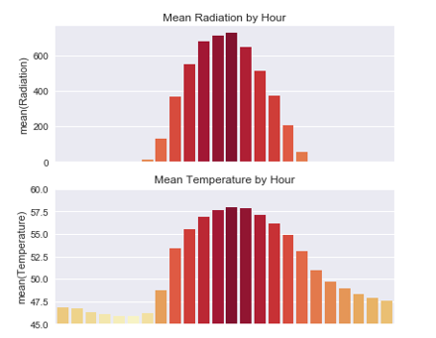
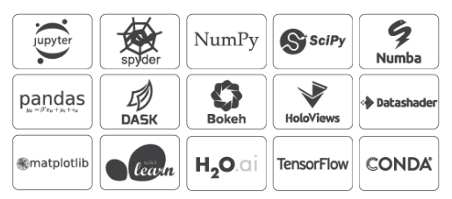
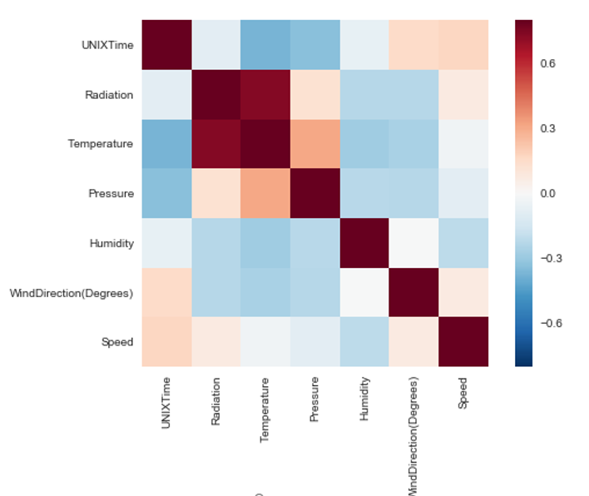
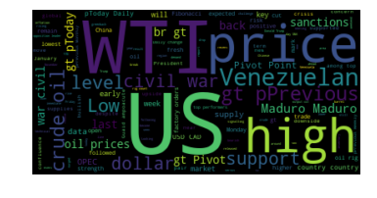

Why python?

Slide 4
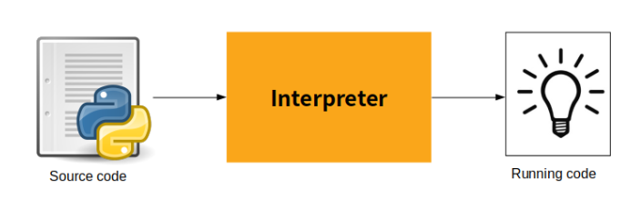
How Python work ?
Highly readable language
Less syntactic exceptions
Superior string manipulation
Elegant and dynamic typing
Ideal for scripting and rapid application
Fit for many platforms
Free and free IDE
Interesting Podcast : python past, present and future with Guido Van Rossum

Slide 5

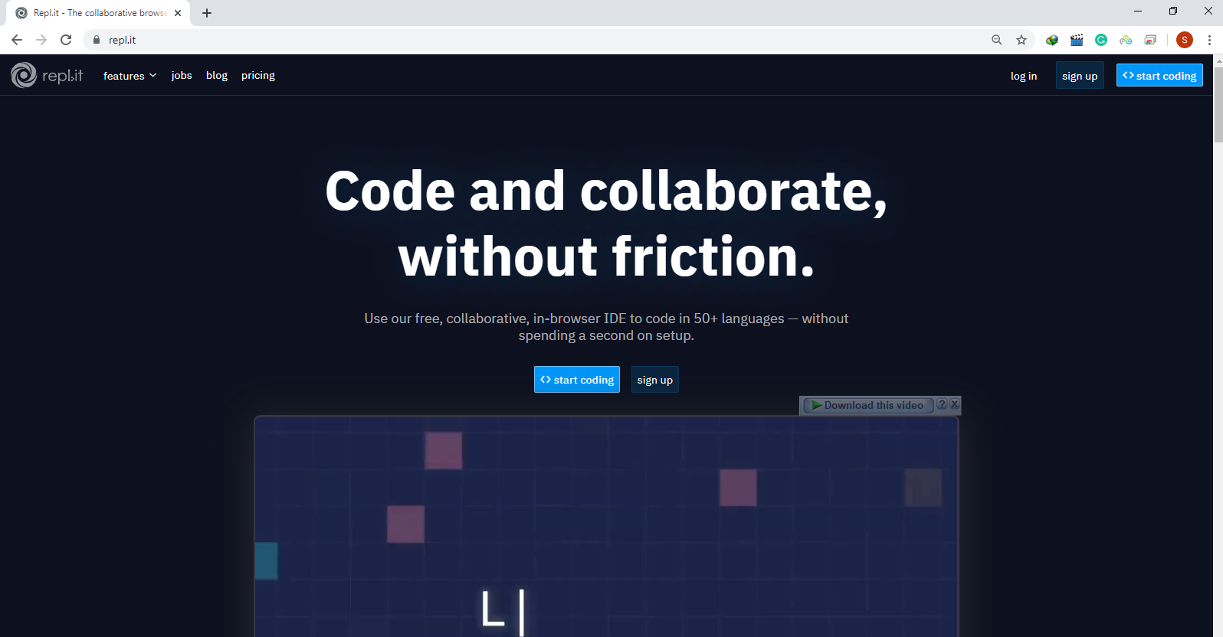

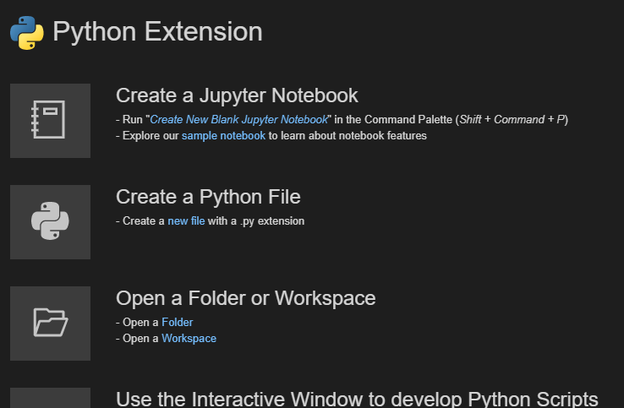
How install? what IDE?
PyCharm
Repl.it (Online Python code IDE)
www.repl.it
Anaconda Navigator
Spyder suitable for code debugging (Recommended for beginers)
Jupiter Notebook for code representation
Misrosoft Visual Studio Code
Suppport Jupiter Notebook (.ipynb)
Use Windows PowerShell for terminal
Access to git in terminal
Install Microsoft VS Code
https://www.anaconda.com/distribution/

Slide 6
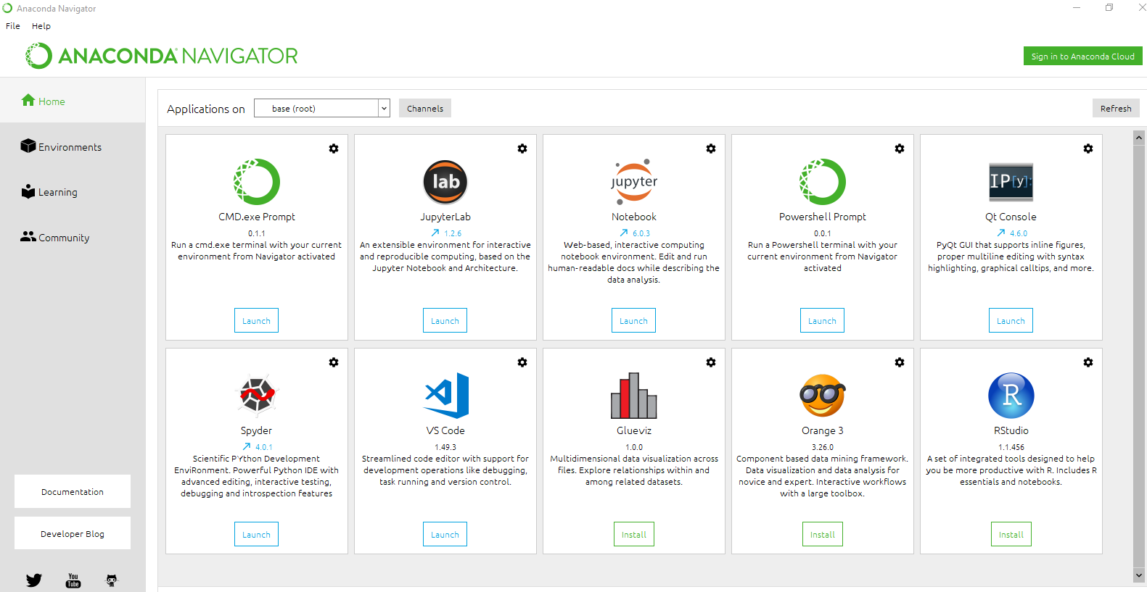
In this class?
Anaconda navigator

Slide 7
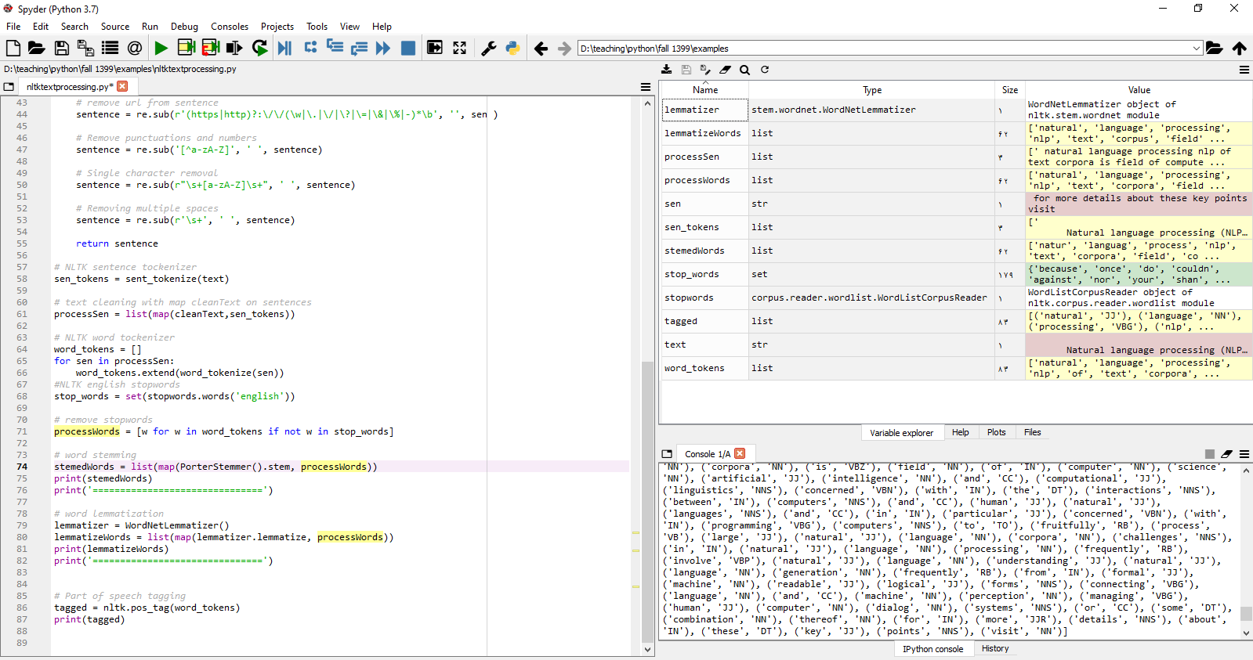
In this class?
Variable Explorer, Plot area and
Files explorer
Edditor
Console
Spyder 4 IDE

Slide 8
What Version Of Python ?
Python 2.7
Python 3.7
Python 3.8

Slide 9
How install packages?
Pip package manager
Anaconda conda package manager

Slide 10
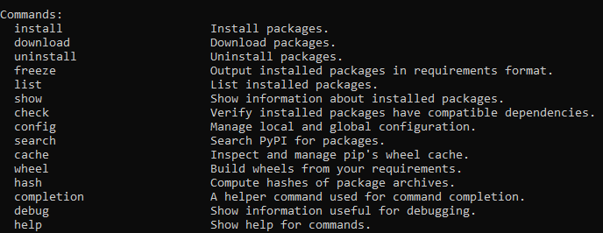
pip package manager
pip < command > [ options ]
Check the pip version
Upgrade pip version

Slide 11
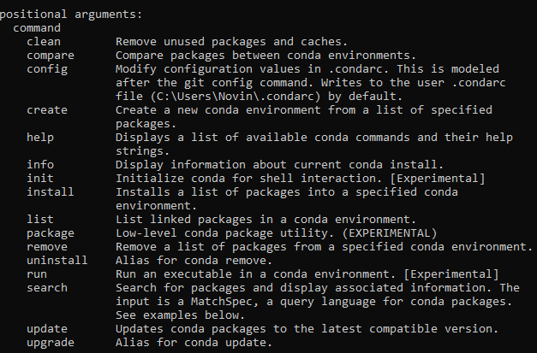

conda package manager
Conda <command> [options]
Check the conda version
Conda cheat sheet

Slide 12
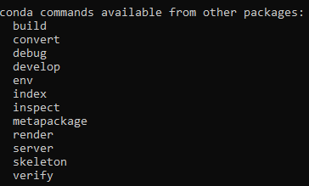

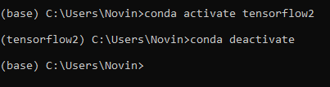
conda package manager (Virtual Environment)
Conda <command> [options]
Conda create virtual environment
Conda activate virtual environment
Conda deactivate virtual environment
Conda manage environment

Slide 13
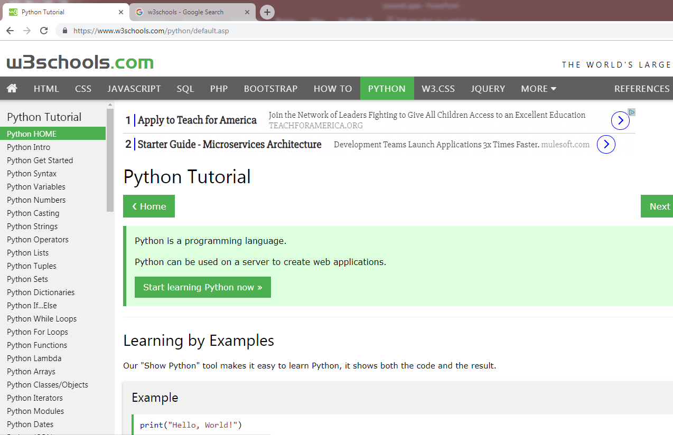

What Reference for starting?
www.w3schools.com

Slide 14
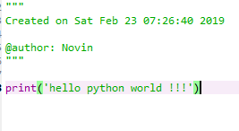
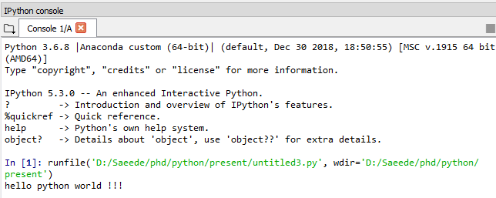
Hello world !
Very Simple
Useful video about Python Graphical User Interface

Slide 15



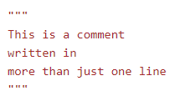
Syntax notes
Python uses indentation to indicate a block of code.
If indentation does not match any outer indentation, you will see this error in terminal
Comment in python
One line comment
Multiline comments:
Useful video about Python Graphical User Interface

Slide 16
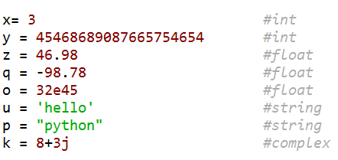
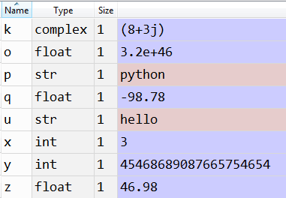
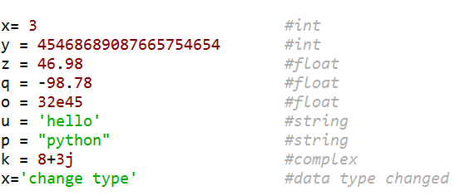
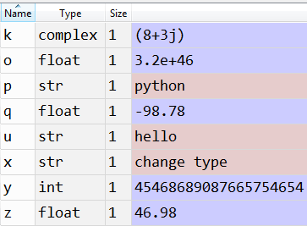
Variables (late binding)
Data types in python

Slide 17
Python collections or iterable objects
List is a collection which is ordered and changeable. Allows duplicate members.
thislist = [‘apple’, ’banana’, ’cherry’]
Tuple is a collection which is ordered and unchangeable. Allows duplicate members.
thistuple = (‘apple’, ’banana’, ’cherry’)
Set is a collection which is unordered and unindexed. No duplicate members.
thisset = {‘apple’, ’banana’, ’cherry’}
Dictionary is a collection of key and values which is unordered, changeable and indexed. No duplicate members.
thisdict = { "brand": "Ford", "model": "Mustang", "year": 1964 }
Collections in python

Slide 18


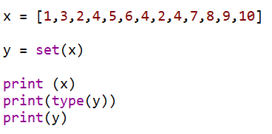

Type casting
Use the type() function for evaluating the type of objects
If you want to specify the data type, you can use the following constructor functions
int()
float()
str()
list()
set()
dict()
Example
Example
Variable types in python

Slide 19
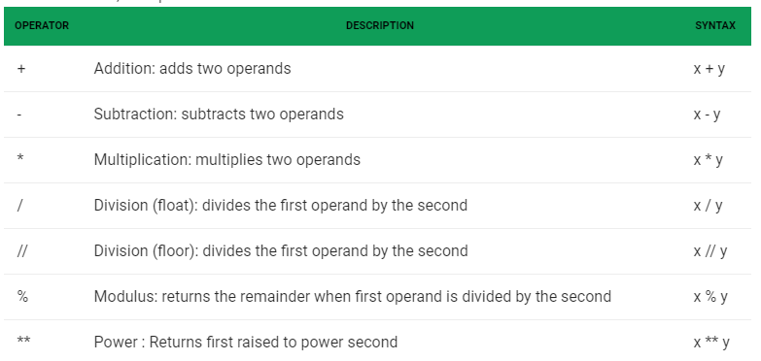
operators
Arithmetic operator
geekforgeek

Slide 20
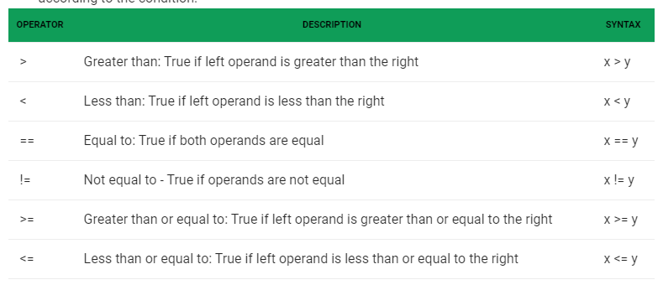
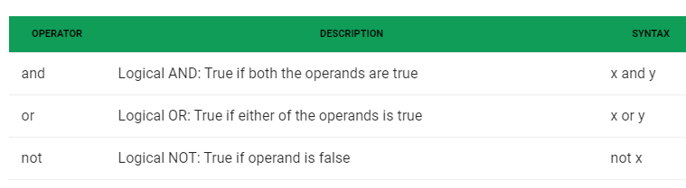
operators
Relational Operators
Logical operators
geekforgeek

Slide 21
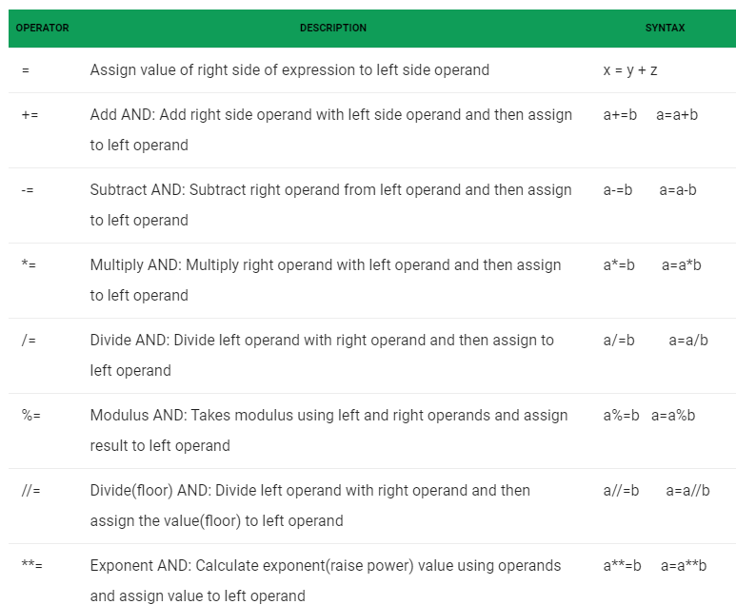
operators
Assignment operators
geekforgeek

Slide 22
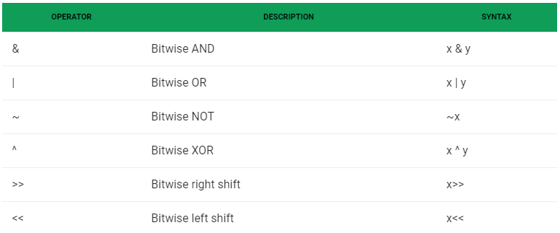
operators
Bitwise Operators
Special operators
OPERATOR | DESCRIPTION | SYNTAX
is | is and is not are the identity operators both are used to check if two values are located on the same part of the memory. Two variables that are equal does not imply that they are identical. | x is y
not is |  | x is not y
in | in and not in are the membership operators; used to test whether a value or variable is in a sequence. | x in y
not in |  | x not in y
Read more about operator in geekforgeek

Slide 23
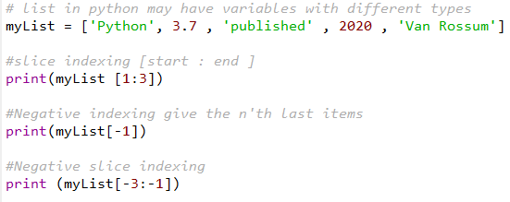

Iterable object indexing
Specify the start index and the end index, separated by a colon, to return a part of the object as an iterable.
obj[start:end] : from custom start index to end index.
obj[start:] : from start index to the last item in iterable object.
obj[: end] : from first item in obj to the custom end index.
Use negative indexes to start the slice from the end of the list.
obj[-start :] : the last start’th values
obj[-start:end] : from the last custom start index through after custom end index
obj[: -end] : from start of obj to the last end’th values
Example
slice indexing in python

Slide 24
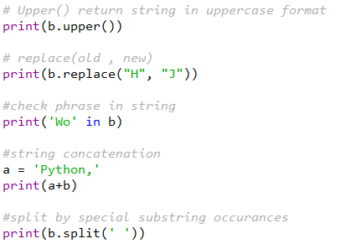
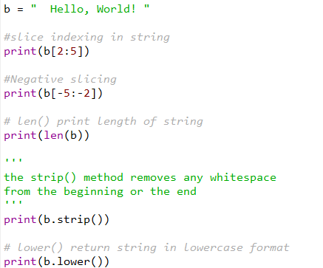
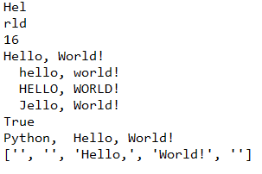
String in python
String in python is iterable object
Example for
len()
string.strip()
string.lower()
string.upper()
string.replace()
string concatenation with + operator
string.split(seprator)
string in python

Slide 25
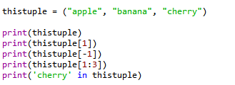


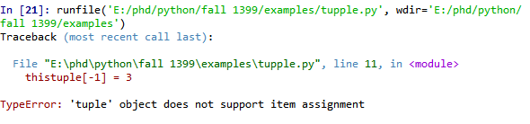
tuple
A tuple is a collection which is ordered and unchangeable.
In Python tuples are written with round brackets.
Example 1
Output
Example 2
Output
tuple in python
slice indexing in python

Slide 26


Lists
list in python differ from array in C# or C++
List items can be have different data type !!!
Example 1
Example 2
Output
Output
List in python
slice indexing in python

Slide 27

Lists
list in python differ from array in C# or C++
Multidimensional list can be have different dimension!!
Example 1
Output
Example 2
Output
List in python
slice indexing in python

Slide 28


Lists
List.append(x)
Add an item to the end of the list. Equivalent to a[ len(a) : ] = [x].
Example 1
Example 2
Output
Output
List in python
slice indexing in python

Slide 29

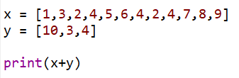
Lists
Join two list
List.extend ( iterable )
Operator +
Example 1
Example 2
Output
Output
List in python
slice indexing in python

Slide 30


Lists
list.insert( index , value )
Insert an item at a given position.
Example 1
Output
list.count(x)
Return the number of times x appears in the list.
Example 2
Output
List in python
slice indexing in python

Slide 31
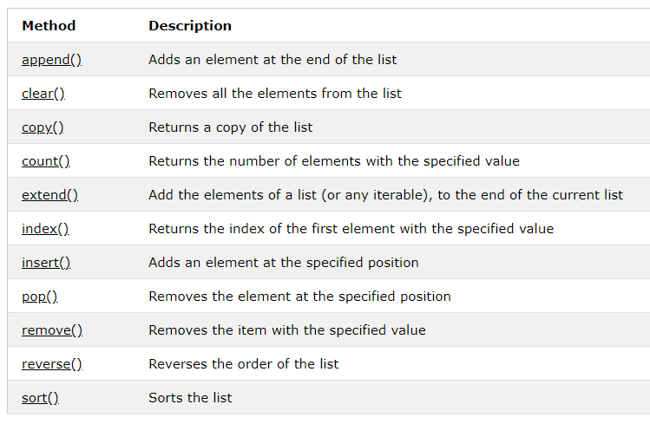
Lists
Python has a set of built-in methods that you can use on lists.
List in python
slice indexing in python

Slide 32
Exercise
Write these programs in your IDE and push these codes in your github account
Complete the operator section in geekforgeek
Complete taking input section from user in geekforgeek
Complete output formatting section in geekforgeek
Complete string section in geekforgeek
Complete tuple section in geekforgeek
Complete list section in geekforgeek
Please share me your codes (anbaee.ac@gmail.com)
slice indexing in python

